Slide 1
DR SNSRCAS, CBE Human Centered Design Thinking Fundamentals 21PCA204 I MCA ODD SEM UNIT 1 lean and Business Model Canvas

Slide 2
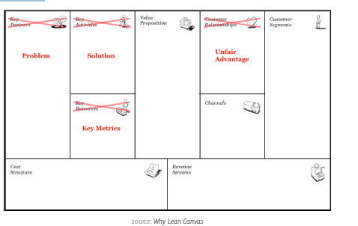
lean and Business Model Canvas
An actionable blueprint for product and market development, the Lean Canvas was
adapted from the Business Model Canvas. It overlaps a lot with a project kickoff plan
in defining the key problems it’s solving, customer segments, it’s unique offering,
details of the solution, key metrics, and so forth. The Lean Canvas, however, is more
strategic while the Project Kickoff Plan is more tactical so they are complementary
to some degree.

Slide 3
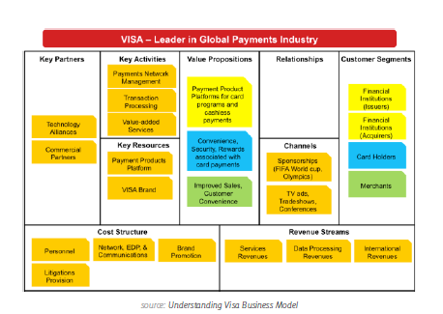
lean and Business Model Canvas
As you can see above, The Lean Canvas has 4 main differences from its Business
Model Canvas predecessor. According to Cloudfire CEO, Ash Maurya, these
changes help companies address the riskiest elements of business ideas. By
focusing on problems instead of key partners, you reduce the chance of building
the wrong product. By considering key metrics instead of key resources, you keep
the product focused on impacting only the metrics that matter. It’s important to not
get overwhelmed by the lean canvases — they aren’t meant to be perfect, so at this
early stage its more important to get something down on paper. A completed Lean
Canvas can be found here, and you can use this template when you’re ready to get
started.

Slide 4
lean and Business Model Canvas
If you’re a larger company, the above Business Model Canvas template might be a
more suitable option because it takes existing partners and resources into account.
Key partners, key resources, and customer relationships are left out of the Lean
Canvas but all have tremendous impact on how enterprises design, manufacture,
and distribute products. For example, the next version of your smartphone might be
half the size and twice as fast, but that may only appeal to your costliest customers
(and might infringe on existing patents).
For a hybrid option, you can also use the Javelin Experiment Board for turning goals
into actionable items. This method combines the ”Get out of the building” mentality
of Lean Canvas with the enterprise elements of the Business Model Canvas. You can
find a template here.

Slide 5
THANK YOU

